Slide 1


Summer Internship MOOC’s
Name: M Lakshmi Narasa Reddy
Registration number:11902757
Course code: CSE443
MOOC’s course name: Data Structures and Algorithms

Slide 2


Content:
1. Introduction
2. Data Structures
3. Basic operations
4.Project

Slide 3
Why Data Structures
Data structure provides a means of organizing, managing, and storing data efficiently.

Slide 4
Introduction
Asymptotic Notation:
-> Asymptotic notations are mathematical tools to represent the time complexity of algorithms for asymptotic analysis.
Types of Asymptotic notation:
1.Theta notation:
-> The theta notation bounds a functions from above and below, so it defines exact asymptotic behavior.
2. Big O notation:
-> The Big O notation defines an upper bound of an algorithm, it bounds a function only from above.
3.Omega notation:
-> Ω notation provides an asymptotic lower bound. And also it is the least used notation among all three notations.

Slide 5
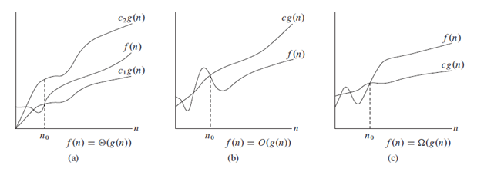

Slide 6
Time Complexity:
-> It is important to analyze an algorithm after writing it to find it's efficiency in terms of time and space in order to improve it if possible. Every algorithm should follow the time space trade-off.
Types of Time complexity:
Worst Case-> In the worst-case analysis, we calculate upper bound on running time of an algorithm.
Average case-> In average case analysis, we take all possible inputs and calculate computing time for all of the inputs.
Best case-> In the best-case analysis, we calculate lower bound on running time of an algorithm.

Slide 7
Analysis of loop:
O(1): Time complexity of a function is considered as O(1) if it doesn't contain loop, recursion and call to any other non-constant time function.
O(n): Time Complexity of a loop is considered as O(n) if the loop variables is incremented or decremented by a constant amount.
O(n^2): Time complexity of nested loops is equal to the number of times the innermost statement is executed.
O(log n): Time complexity of loop is considered as O(log n) if the loop variable is divided or multiplied by a constant amount.

Slide 8

Data Structures
Arrays
Linked list
Stack
Queue
Tree
Graph

Slide 9
Linear Data Structures
A Linear data structure have data elements arranged in sequential manner and each member element is connected to its previous and next element, which helps to traverse a linear data structure in a single level and in single run.
It includes Array, Linked list, Stack and Queue.

Slide 10
Arrays
An array is a collection of items of same data type stored at contiguous memory locations.
Location of the next element depends on the datatype of the element.
Arrays allows to access elements randomly. Elements in an array can be accessed using indexes.
Advantage: due to the fact we can randomly access the elements, it gives a better performance as access time become faster.
Operations: searching, insertion and deletion, reversing , rotating

Slide 11
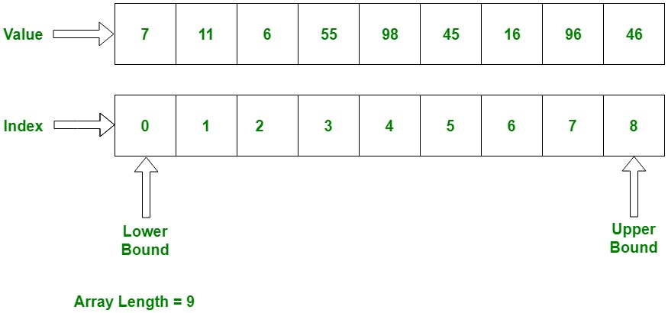

Slide 12
Linked List
Linked Lists are linear or sequential data structures in which elements are stored at non-contiguous memory location and are linked to each other using pointers.
Each linked list has two parts : data and next pointer
A linked list has a head and a tail pointer.
Types of linked list:
Singly linked list b. doubly linked list c. circular linked list
Operations: searching, insertion and deletion.

Slide 13
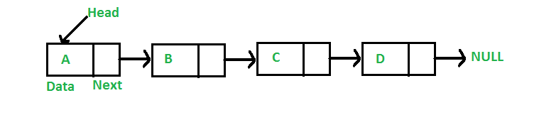

Slide 14
Stack
The stack is a linear data structure which follows a particular order in which the operations are performed. The order may be LIFO(Last In First Out) or FILO(First In Last Out).
The LIFO order says that the element which is inserted at the last in the Stack will be the first one to be removed. In LIFO order insertion takes place at the rear end of the stack and deletion occurs at the front of the stack.
The FILO order says that the element which is inserted at the first in the Stack will be the last one to be removed. In FILO order insertion takes place at the rear end of the stack and deletion occurs at the front of the stack.
Operations: push, pop, peak or Top , isEmpty
It can be implemented in two ways using arrays and linked list.
Pros: Easy to implement. Memory is saved as pointers are not involved. Cons: It is not dynamic. It doesn’t grow and shrink depending on needs at runtime.

Slide 15
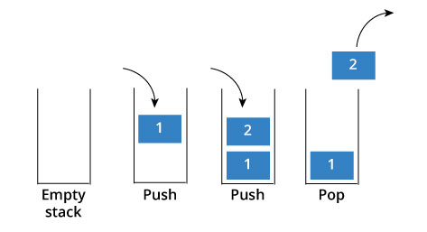

Slide 16
Queue
Queue is also a linear data structure which follows a particular order in which the operations are performed.
The order is First In First Out (FIFO) which means that the element which is inserted first in the queue will be the first one to be removed from the queue.
It can be implemented using array, linked list and stack.
Operations:
Enqueue: Adds an item to the queue. If the queue is full, then it is said to be an Overflow condition.
Dequeue: Removes an item from the queue. The items are popped in the same order in which they are pushed. If the queue is empty, then it is said to be an Underflow condition.
Rear: Get the last item from queue. Here happens the insertion
Front: Get the front item from queue. Here happens the deletion.

Slide 17
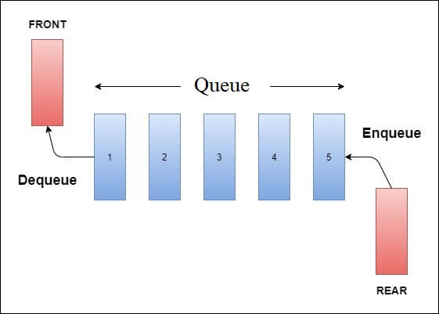

Slide 18
Non-linear Data Structure
A non-linear data structure has no set sequence of connecting all its elements and each element can have multiple paths to connect to other elements.
It includes Tree and Graph.

Slide 19
Tree
A Tree is a non-linear data structure where each node is connected to a number of nodes with the help of pointers or references.
Basic terminologies in tree: Root node, leaf node, edge, siblings, height of tree
Binary tree:
-> A Tree is said to be a Binary Tree if all of its nodes have at most 2 children. That is, all of its node can have either no child, 1 child or 2 child nodes.
Types of binary tree: Proper binary tree, Complete binary tree, Perfect binary tree.
Operations: Traversal, Insertion, Deletion.

Slide 20
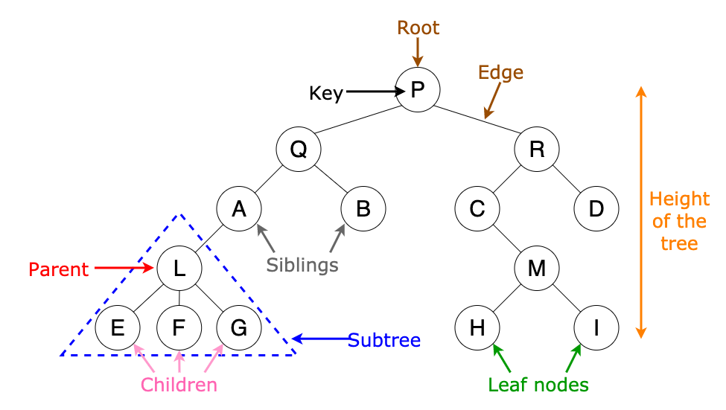

Slide 21
Graph
A graph is a data structure that consists of nodes and edges :
1.A finite set of vertices also called nodes.
2. A finite set of ordered pair of the form (u, v) called as edge.
Two types:
Directed graph : The Directed graphs are such graphs in which edges are directed in a single direction.
Undirected graph: Undirected graphs are such graphs in which the edges are directionless or in other words bi-directional.
Operations: Traversal(Two types)
Breadth first traversal
Depth first traversal

Slide 22
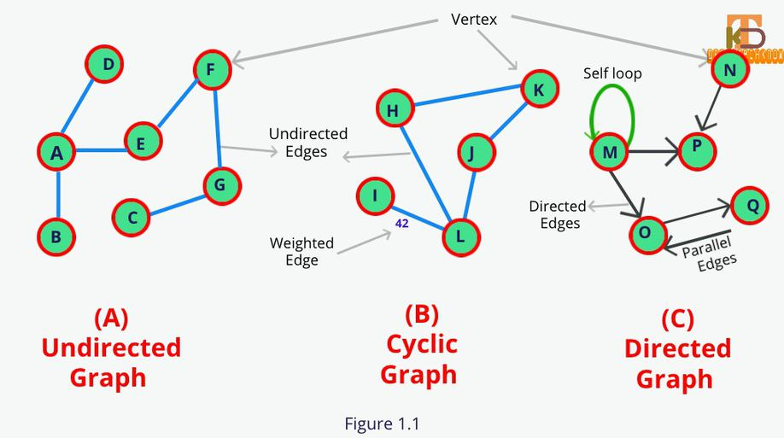

Slide 23
Operations on Data Structures
Traversal
Insertion
Deletion
Searching
Sorting

Slide 24
Traversal
A data structure contains elements, Traversing a data structure means: "visiting" or "touching" the elements of the structure, at least once and doing something with the data
Traversing is also sometimes called iterating over the data structure

Slide 25
Insertion
Insert operation is to insert one or more data elements into the data structure.
Based on the requirement, new element can be added at the beginning, end or any given index(location) of the structure.
It results in the increased number of elements in the structure

Slide 26
Deletion
Deletion refers to removing an existing element and re-organizing all elements of the data structure.
To perform deletion of a particular element one first needs to search the presence of that very element in the structure.

Slide 27
Searching
Searching means searching a particular element in any data structure.
Two types:
Linear search: It is also known as sequential search.
Time complexity: O(n)
b. Binary search: Binary Search performs the search operation by repeatedly dividing the search interval in half.
Also binary search can be performed only on sorted arrays and it is also more efficient than the linear search algorithm.
Time complexity: O(Log n)

Slide 28
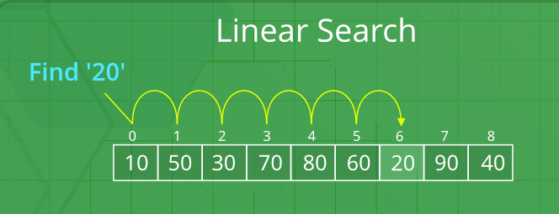

Slide 29
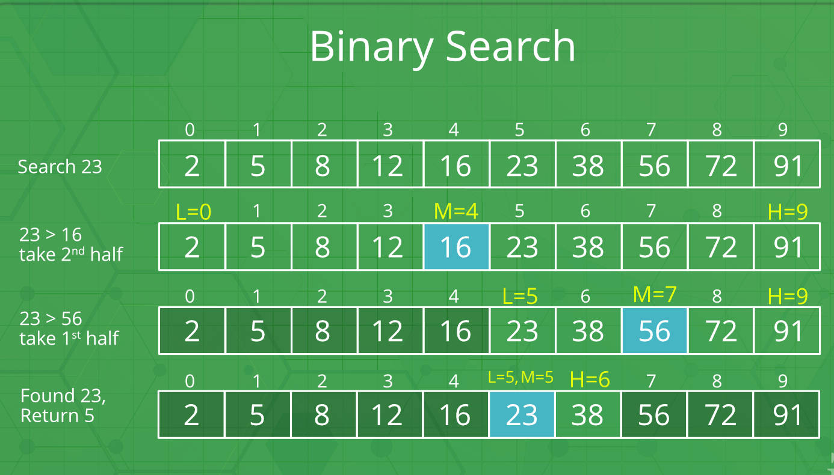

Slide 30
Sorting
Sorting any sequence means to arrange the elements of that sequence according to some specific criterion.
Types:
Insertion sort: O(n^2)
Selection sort: O(n^2)
Bubble sort: O(n^2)
Quick sort: O(n^2)
Merge sort: O( Log n)

Slide 31

Project
Boggle Game Solver

Slide 32
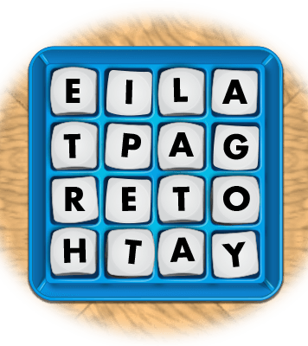
Boggle game solver
Boggle is a word game played using a plastic grid of lettered dice, in which players attempt to find words in sequence of adjacent letters

Slide 33
Rules
You must find as many words as possible from the grid at least of length 3.
You can move from one letter to another if it is a neighbour(in all eight neighbours).
You cannot use a letter more than once in a word
You get points for each word

Slide 34
Implementation
Input
Input the Boggle board
Input
Input dictionary to valid Data Structure (Trie)
Calculate
Calculate all possible words by traversing the boggle board
Show
Show all valid words

Slide 35
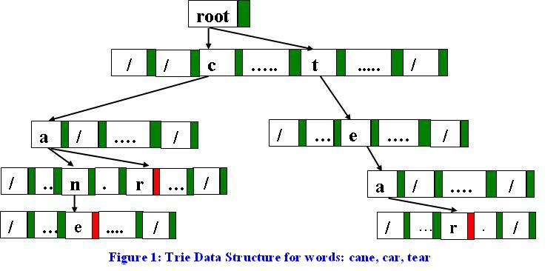
Structure of Trie
class TrieNode
{ char data;
TrieNode []child;
boolean isWord;
TrieNode(char c)
{this.data=c;
isWord=false;
child=new TrieNode[26];
}
}

Slide 36
Code of Boggle game solver
Git Hub link:
Boggle Game Solver

Slide 37

Certificate

Slide 38
Thank YOU

